Slide 1
R.E.A.D.Y. “Bible Studies In Song”
Preparing For The Journey Through a Bible Study Series in Song

Slide 2
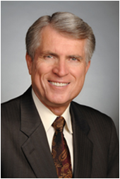
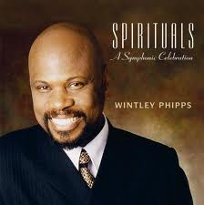
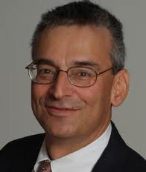
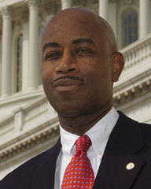
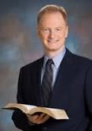
R.E.A.D.Y. “Bible Studies In Song”
Preparing For The Journey Through a Bible Study Series in Song

Slide 3
1 Corinthians 14.15
What is it then? I will pray with the spirit, and I will pray with the understanding also: I will sing with the spirit, and I will sing with the understanding also.
Colossians 3:16
Let the word of Christ dwell in you richly in all wisdom; teaching and admonishing one another in psalms and hymns and spiritual songs, singing with grace in your hearts to the Lord.

Slide 4
Overview/Summary
HOLY SPIRIT+SCRIPTURE+MUSIC=R.E.A.D.Y.
R
Revival & Reformation
E
Evangelism
A
Admonition
D
Discipleship
Y
Yearning…
for the Holy Spirit–& heaven!

Slide 5
Overview/Summary
Based on Bible & Spirit of Prophecy
Unique, innovative
Employs both left and right brain hemispheres (bypasses usual barriers)
Multi-disciplinary–
multi-ministries, multi-artists
Multi-lingual: Spanish, Hebrew, (others to follow)

Slide 6
Overview/Summary
Target Groups
SDA’s who are in earnest about being ready and who desire new appealing, nonthreatening ways to share Christ with family, friends, colleagues, clients, patients
Secular/un-churched, and other faith communities, who may be more readily accessible via audio-visual
Christians who want to be equipped to give Bible studies but fear they will not remember key texts
Sleeping “foolish virgins” without “oil” in their lamps)
Difficult-to-reach audiences using TV and Internet (web-based multi-ethnic, multi language outreach)

Slide 7
R.E.A.D.Y. OVERVIEW
HOLY SPIRIT+SCRIPTURE+MUSIC=R.E.A.D.Y.
TWO PHASES (COMPONENTS):
1
TEN COMMANDMENT “LOVE AT WORK” EVANGELISTIC CONCERT
2
TEN END-TIME BIBLE STUDIES
(CONNECTED TO 10 COMMANDMENTS & GC)

Slide 8
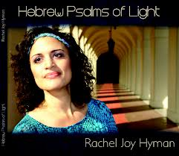
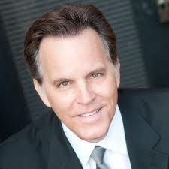
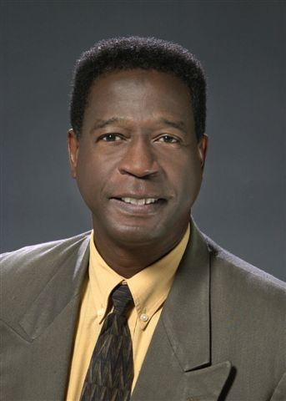
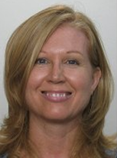
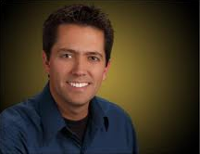
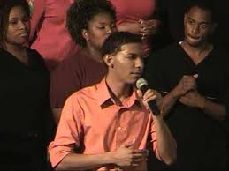
“Love At Work”
“R.E.A.D.Y. Ten Commandment Evangelistic Concert
Singers
Neville Peter Steve Darmody Jennifer LaMountain Rudy Micelli Rachel Hyman
Charles Haughabrooks Julie Penner Christian Berdahl Yolanda Palmer Stevie Mackey

Slide 9
Southern Calif Conf Pilot Poster

Slide 10
“Love At Work”
“R.E.A.D.Y. Evangelistic Concert
Ten Singers
Theme (God’s “L.A.W.” & Grace)
Testimonies
Appeal
Invitation (to attend READY f/u*)
Concert Specs
Concert length (90 -100 min {plus 5 min for offering})

Slide 11
Ten End-Time Bible Studies: READY Study
Curriculum: Ten End-time Bible studies based on Ten Commandments “Love At Work” Concert, and focused on preparing for the journey—being ready– through the power of the Holy Spirit using God’s Word set to song.
r.e.a.d.y Bible Studies in Song

Slide 12
“READY Study”-- Ten End-Time Bible Studies
--Based on God’s Ten Commandments (plus 1 overview study on “Law & Grace” plus concert =12 presentations)—
preparing for the journey, being ready– for heaven through the power of the Holy Spirit using God’s Word set to song.
r.e.a.d.y Bible Studies in Song

Slide 13
Bible Study Curriculum
r.e.a.d.y Bible Studies in Song

Slide 14
“R.E.A.D.Y. Bible Studies
“Preparing For The Journey Through a Bible Study Series In Song
Principal Contributor/Editor: Clifford Goldstein
Adapted for Screen by Steven Mosely
With Personal Pastoral Testimonies by Spirit-filled pastors/evangelists including…
Lonnie Melashenko Wintley Phipps Clifford Goldstein Barry Black John Bradshaw

Slide 15
READY EVANGELISTIC TOOL: OPTIONS
1
READY Evangelistic “Reaping” Campaign
2
READY Church or Home Group Bible Study
3
“Gift Track” for “Busy Professionals Evangelism” & Traditional Evangelistic Campaign (Gift Tool)
4
Other Options: The sky is the limit…

Slide 16
Recommended/Optimal Option
Phase 1
(4-6 wks before)
Phase 2
(Concert)
Phase 3
(as per Pastor)
Preparation
“READY Emphasis Sabbath” Purpose:
Inform church re Ready Project
Save the date
Sermon: “Ready”
Members fill Friend-ship Evangelism Commitment card with name of at least 1 friend or family they will invite to concert.
(Option: Share above at READY Rally 4 wks before
Concert
Includes:
Testimonials
Stirring Appeals
Invitation to join follow up evang. series or to join a READY Study
Guests given gift/voucher for CD or DVD of musical (pick up gift at start of f/u meetings)
Follow Up
Options include
READY STUDY
Workshop
Home Study Groups
Prayer Meeting
Other (e.g. Gift Track/survey)
Traditional Evang Campaign, & use READY CD/DVDs as gifts/adjuncts
(Guests turn in voucher for DVD)

Slide 17
READY Camp Meeting “Express”
Phase 1
Phase 2
In-reach/Out-reach
Sabbath Afternoon: “Love At Work” Evangelistic Concert.
All are then invited to attend 5 day READY Study “Express Track” on the 5 S’s (pillars)
The READY Study
(Bible Studies in Song Workshop)
Covers:
Sabbath
Sanctuary
State of the Dead
Spirit of Prophecy
Second Coming

Slide 18
Basic Option: READY “Out-reach” Tool
Phase 1
Phase 2
Evangelistic campaign Guests turn in voucher from concert to receive “Love At Work” CD. Guests + SDA’s receive CD whenever relevant READY topic presented (Sabbath, state of dead, Sanctuary, etc)
Out-reach
Church invites non-SDA guests to “Love At Work” Concert. At the concert, guests given voucher and invited to evangelistic campaign

Slide 19
As the people journeyed through the wilderness, many precious lessons were fixed in their minds by means of song…. The commandments as given from Sinai, with promises of God’s favor and records of His wonderful works for their deliverance, were by divine direction expressed in song, and were chanted to the sound of instrumental music, the people keeping step as their voices united in praise. – Ed 39

Slide 20
“…the words of the angel even now seem to ring in my ears, "Get ready, get ready, get ready. Time is almost finished, almost finished, almost finished. Cry, cry, for the arm of the Lord to be revealed, for the arm of the Lord to be revealed. Time is almost finished. What you do, you must do quickly!” 8MR 222.4

Slide 21
QUESTIONS???
Thank You !
Heart & Soul International &
The READY Steering Committee
Pastor Brian Neal Schubert Palmer
Pastor Mark Pappendick Yolanda Palmer
Pastor Kyle Allen Ray Cloete
Pastor Alvin Maragh
Pastor Ben Del Pozo
Pastor Adolphus Garnett
www.ReadySDA.org
(855) 77-READY

